Slide 1
RAILWAY RESERVATION SYSTEM

Slide 2
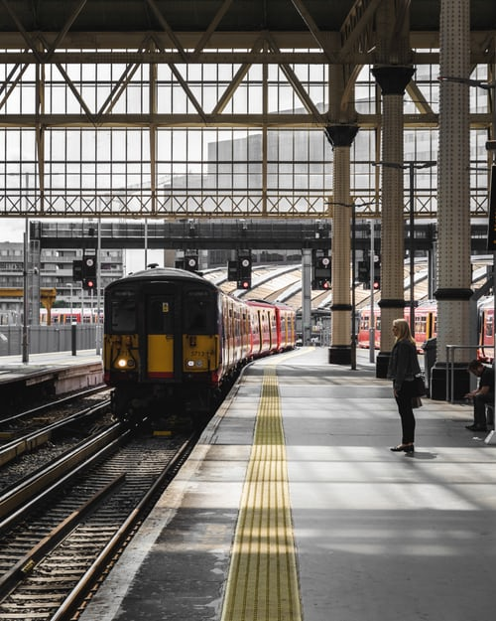
PRESENTATION STEPS
01 Team Introduction
02 Problem Statement
03 Work Division
04 Experience

Slide 3



MEET THE TEAM
Azlan
Aleena Minhaj
Aamish

Slide 4
E project Statement
This Application enables us to choose the train even there is no necessary to fill a form at the railway reservation counter ,i.e. we can directly select from the choices provided for us with train numbers and their origin,
departure time, destination &amp; arrival time at that station and the class to
travel in. Application gives us the final output as train ticket with the amount to be paid.

Slide 5
Work Division
Designing:
Aleena Minhaj
Azaln
Aamish
Database:
Aleena Minhaj
Logic Design:
Aleena Minhaj
Data Collection:
Aleena Minhaj
Azaln
Aamish
Documentation:
Azlan
Aamish

Slide 6

Overall Experience
This is a good opportunity to attend e-project to polish our skills. And ready to step-in in the professional life and face actual difficulties this is the best way to experience.
We would like to express our special thanks of gratitude To e-project team and Aptech to give us an opportunity to improve our skills. We would like to extend our gratitude to Miss Samreen Rafiq who clear our difficulties and helps us to complete our project on time. ALHUMDULILLAH!

Slide 7

Thankyou

